Slide 1
HTTP 1.1 and the Tomcat Architecture

Slide 2

Overview
HTTP 1.1 is the protocol of the web
Tomcat is a webserver written in Java
- Coyote, Catalina, Jasper

Slide 3
HTTP 1.1

Slide 4








HTTP 1.1 Request and Response
Internet

Slide 5
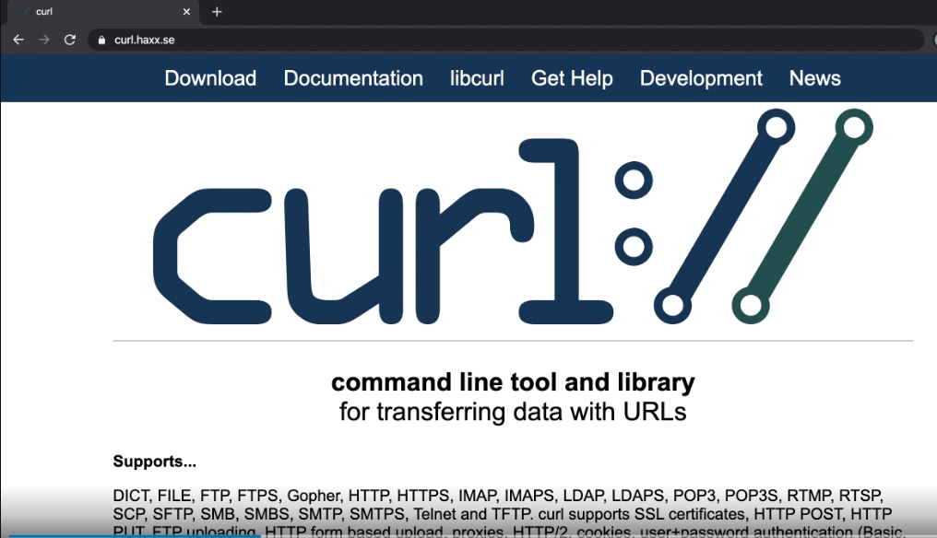

Slide 6

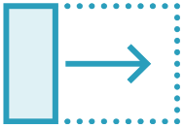


HTTP Methods
GET
POST PUT DELETE

Slide 7
Chrome HTTP Request
GET /example/ HTTP 1.1
Host: localhost:8080 User-Agent: Mozilla/5.0
AppleWebKit/537.36 (KHTML like
Gecko) Chrome/79.0.3883.121
Accept: */*
Headers
101001 111010 100110 111010 100110
100110 111010 001011 101001 111010
111010 100110 101001 111010 100110
101001 111010 100110 111010 100110
100110 111010 001011 101001 111010
111010 100110 101001 111010 100110
Body

Slide 8
iPhone HTTP Request
GET /example/ HTTP 1.1
Host: localhost:8080
User-Agent: Mozilla/5.0 (iPhone; CPU iPhone OS 12_0 like Mac OS
X) AppleWebKit/605.1.15 (KHTML, like Gecko) Version/12.0 Mobile/15E148 Safari/604.1
Accept: */*
Headers
100110 111010 001011 101001 111010
111010 100110 101001 111010 100110
101001 111010 100110 111010 100110
100110 111010 001011 101001 111010
111010 100110 101001 111010 100110
Body

Slide 9
cURL HTTP Request
GET /example/ HTTP 1.1
Headers
Host: localhost:8080 User-Agent: curl/7.6.4 Accept: */*
100110 111010 001011 101001 111010
111010 100110 101001 111010 100110
101001 111010 100110 111010 100110
100110 111010 001011 101001 111010
111010 100110 101001 111010 100110
101001 111010 100110 111010 100110
100110 111010 001011 101001 111010
111010 100110 101001 111010 100110
Body

Slide 10







HTTP 1.1 Request and Response
Internet

Slide 11
HTTP Request
GET /example/ HTTP 1.1
Headers
Host: localhost:8080 User-Agent: Mozilla/5.0 Accept: */*
100110 111010 001011 101001 111010
111010 100110 101001 111010 100110
101001 111010 100110 111010 100110
100110 111010 001011 101001 111010
111010 100110 101001 111010 100110
101001 111010 100110 111010 100110
100110 111010 001011 101001 111010
111010 100110 101001 111010 100110
Body

Slide 12
cURL HTTP Request
GET /example/ HTTP 1.1
Headers
Host: localhost:8080 User-Agent:
Accept: */*
100110 111010 001011 101001 111010
111010 100110 101001 111010 100110
101001 111010 100110 111010 100110
100110 111010 001011 101001 111010
111010 100110 101001 111010 100110
101001 111010 100110 111010 100110
100110 111010 001011 101001 111010
111010 100110 101001 111010 100110
Body

Slide 13
Microsoft Edge HTTP Request
GET /example/ HTTP 1.1
Host: localhost:8080 User-Agent:
Accept: text/html, application/xhtml+xml, image/jxr, */*
Headers
101001 111010 100110 111010 100110
100110 111010 001011 101001 111010
111010 100110 101001 111010 100110
101001 111010 100110 111010 100110
100110 111010 001011 101001 111010
111010 100110 101001 111010 100110
Body

Slide 14
Safari HTTP Request
GET /example/ HTTP 1.1
Host: localhost:8080 User-Agent:
Accept:text/html,application/xhtm l+xml,application/xml;q=0.9,
*/*;q=0.8
Headers
101001 111010 100110 111010 100110
100110 111010 001011 101001 111010
111010 100110 101001 111010 100110
101001 111010 100110 111010 100110
100110 111010 001011 101001 111010
111010 100110 101001 111010 100110
Body

Slide 15
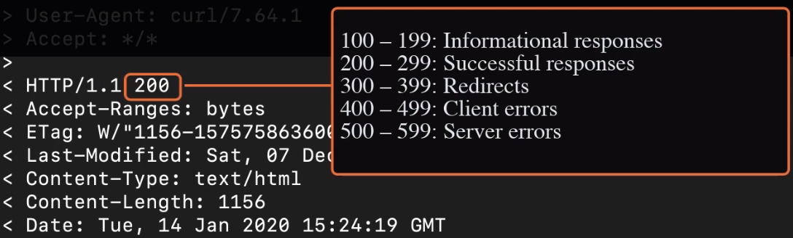

Slide 16
HTTP 1.1 Protocol
Web Browser
Tomcat
HTTP Request [ Method | Headers | Content ]
HTTP Response [ Status Code | Headers | Content ]

Slide 17
Tomcat Architecture

Slide 18

Demo
How HTTP flows through the three Tomcat components
Coyote
Catalina
Jasper

Slide 19


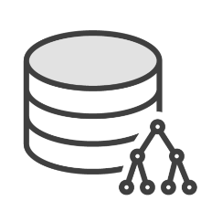

Tomcat Architecture
Web Clients
Tomcat
Resources

Slide 20


Tomcat Architecture
Web Clients
Tomcat
Resources
Coyote

Slide 21



Tomcat Architecture
Web Clients
Tomcat
Resources
Coyote
HTTP Request

Slide 22
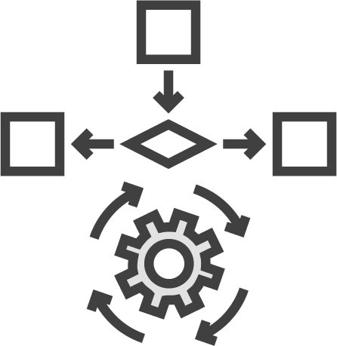


Tomcat Architecture
Web Clients
Tomcat
Resources
Coyote
Catalina
HTTP Request

Slide 23



Tomcat Architecture
Web Clients
Tomcat
Resources
Coyote
Catalina
HTTP Request
Web-Apps

Slide 24



Tomcat Architecture
Web Clients
Tomcat
Resources
Coyote
Catalina
HTTP Request
HTTP Response
Web-Apps

Slide 25
Tomcat Architecture
Web Clients
Tomcat
Resources
Coyote
Catalina
HTTP Request
Web-Apps
JSP

Slide 26



Tomcat Architecture
Web Clients
Tomcat
Resources
Coyote
Catalina
HTTP Request
Jasper
Web-Apps
JSP

Slide 27
Tomcat Architecture
Web Clients
Tomcat
Resources
Coyote
Catalina
HTTP Request
Jasper
Web-Apps

Slide 28


Tomcat Architecture
Web Clients
Tomcat
Resources
Coyote
Catalina
HTTP Request
HTTP Response
Jasper
Web-Apps

Slide 29











Multi-threaded Servlets
Web Clients
Tomcat
Resources
Coyote
Catalina
Jasper
Web-Apps

Slide 30
ServletContextListener
Catalina
Servlet
new Servlet()
init(ServletConfig)
init()
doGet( )
doGet()
destroy( )
destroy()

Slide 31
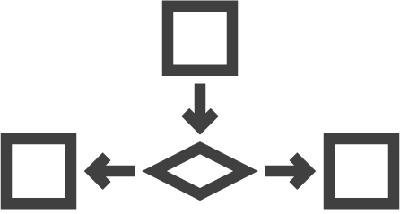
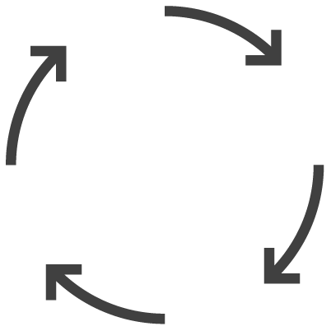












Tomcat Architecture
Web Clients
Tomcat
Resources
Web-Apps
Coyote
Catalina
Jasper

Slide 32
Summary
Good understanding
HTTP 1.1 protocol
Tomcat Architecture
Understanding helps with other modules Next: Developing Servlets

